Slide 1
Table Indexes
Instructor:

Slide 2

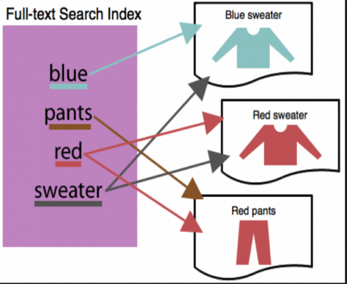
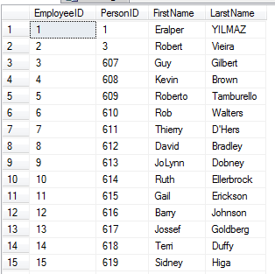
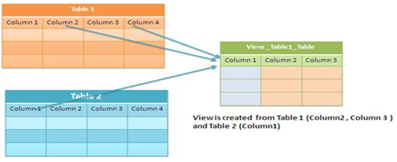
Learning Goals
By the end of this lecture students should be able to:
Create Indexes to improve query retrieval speed
Automatically generate sequence numbers by using a sequence generator
Create, maintain, and use View

Slide 3
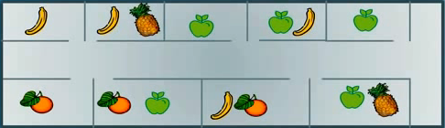
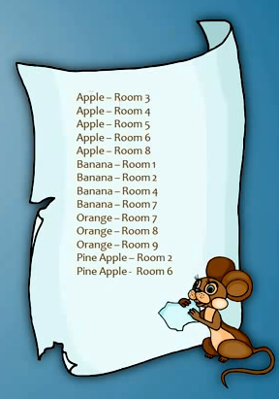





Why use indexes?
An index in database is similar to an index in a book
Indexes in database help speed up search queries. Allow find data in a table without scanning the entire table.
1
2
3
4
5
Late
9
8
7
6
I want bananas …
Result:
1
2
3
4
5
Quick
9
8
7
6

Slide 4
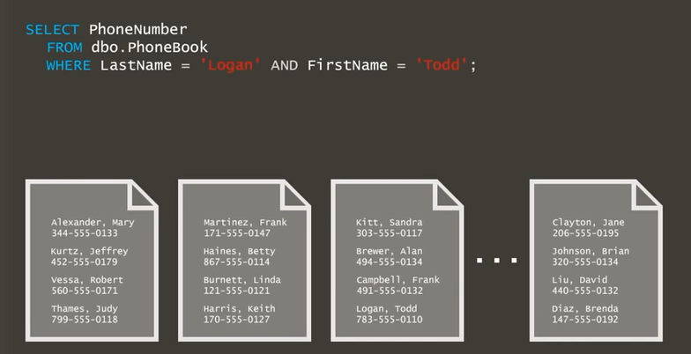
Table Indexes (1/3)
CREATE TABLE dbo.PhoneBook (
LastName varchar(50) NOT NULL,
FirsName varchar(50) NOT NULL,
PhoneNumber varchar(50) NOT NULL
);

Slide 5
Table Indexes (2/3)
CREATE TABLE dbo.PhoneBook (
LastName varchar(50) NOT NULL,
FirsName varchar(50) NOT NULL,
PhoneNumber varchar(50) NOT NULL
);
Result:
783-555-0110

Slide 6
Table Indexes (1/3)
There are 2 types of major Indexes:
Clustered
Data is stored in the order on the clustered index
Only 1 clustered index per table
Usually the Primary Key
Sort and store the data rows in the table based on their key value.
Non-clustered
Data is not stored in the order on the non clustered index
Have a structure completely separate from the data rows.

Slide 7
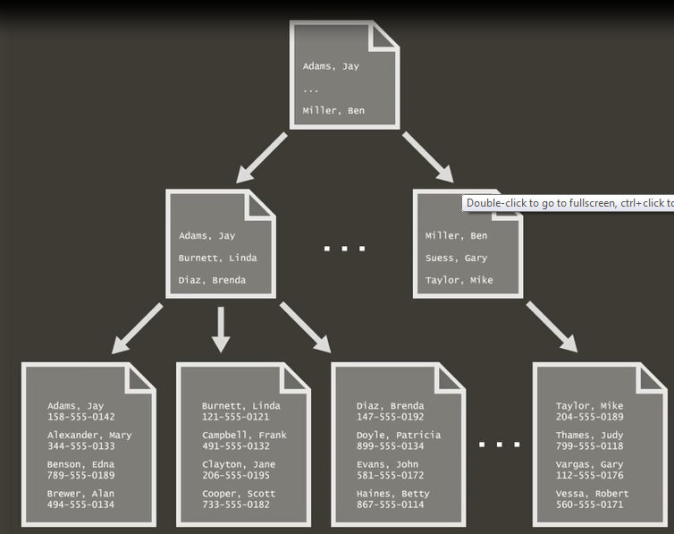
Clustered Index
CREATE CLUSTERED INDEX IX_PhoneBook_CI
ON dbo.PhoneBook (LastName, FirstName)
Index
Data

Slide 8
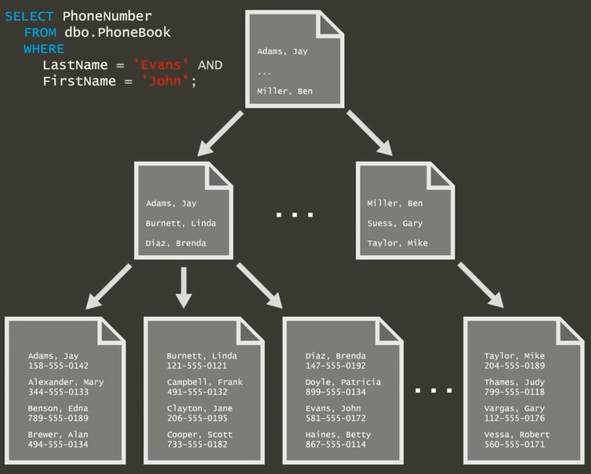
Clustered Index

Slide 9
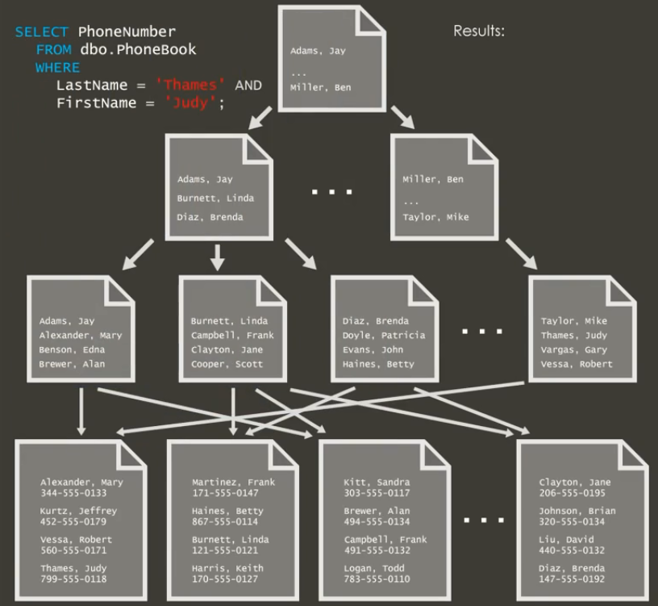

Non - Clustered Index

Slide 10
Creating an Index
Create a new index:
Deleting an Index
CREATE INDEX index_name ON table_name (column1_name, column2_name, …)
DROP INDEX table_name.index_name

Slide 11

Summary
Table Indexes
Why use indexes?
Create, maintain and use index

Slide 12
Thank you
12

